Slide 1

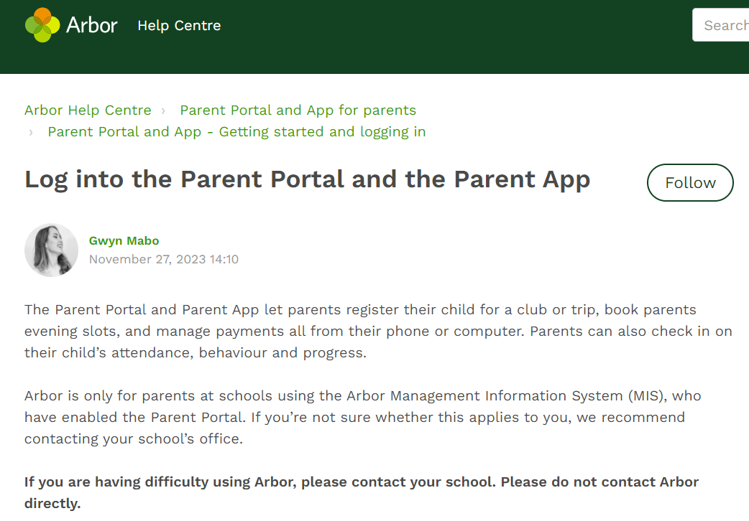
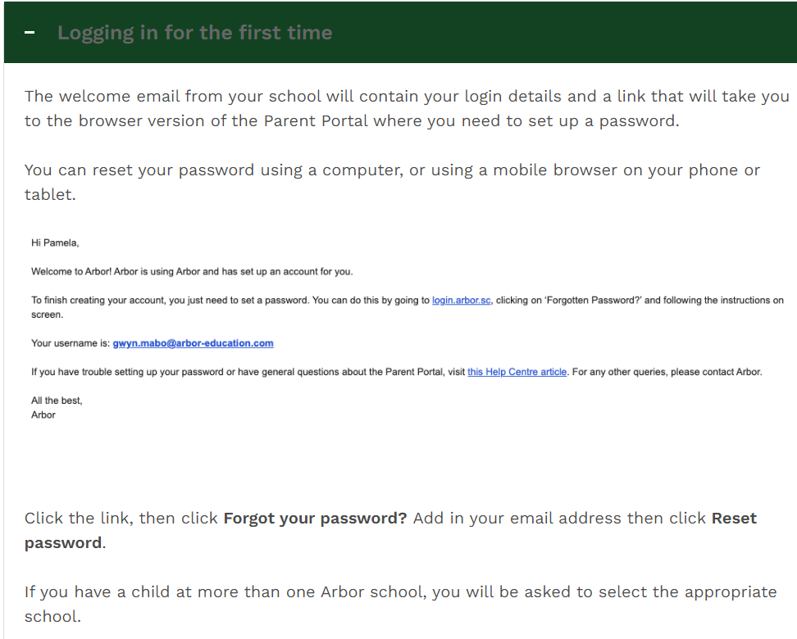
Arbor – log-in and Help Centre
Link to Arbor - our school Management Information System
https://long-marston-va-coe.uk.arbor.sc/?/home-ui/index

Slide 2
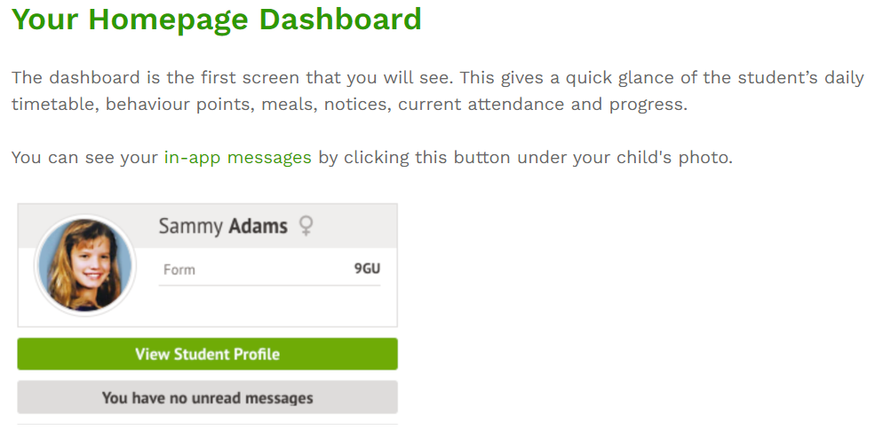
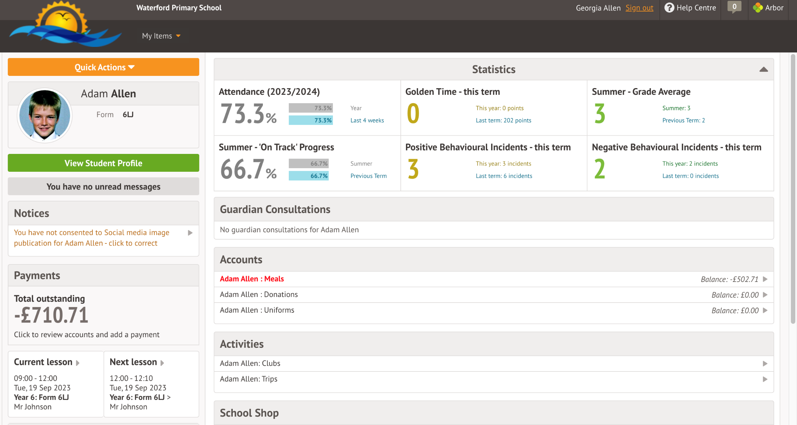

Slide 3
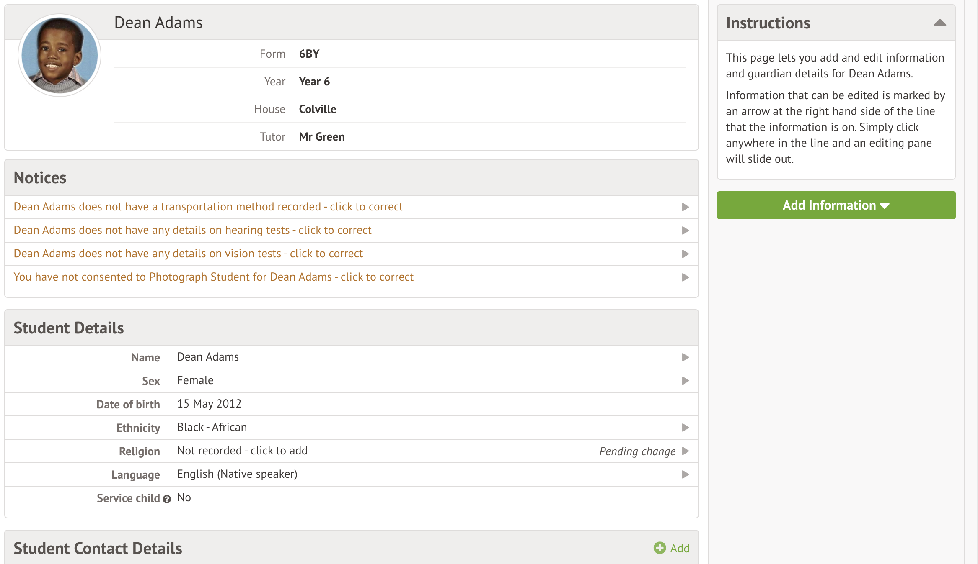
Your student profile…

